Slide 1

Resume <-> Job Matcher
By Nikita Volynskiy and James Rockey

Slide 2
About the Project
Problem:
College students have limited options in finding job descriptions that match their resumes. They should have clarity over what job title their resume represents, as well as what job title a job description represents.
Solution:
1. Compare the job title that their resume most likely represents to the job title a selected job description most likely represents.
2. Based on an inputted resume you can see jobs that have the best fit with the given resume and list them for the user to view.

Slide 3
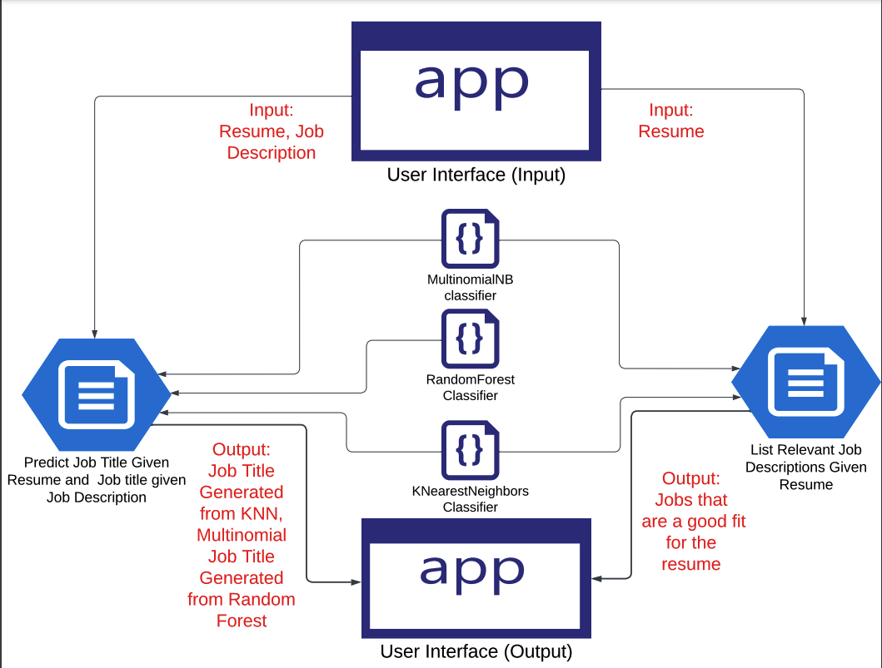
Overall Design

Slide 4
Installation Instructions
Using bash….
Create empty directory
Git clone: https://github.com/nikitav2/CS410CourseProjectFinal
Open a new terminal
python3.9 -m venv .venv
source .venv/bin/activate
python -m spacy download en_core_web_lg
pip install -r requirements.txt
export FLASK_APP=app
flask run

Slide 5
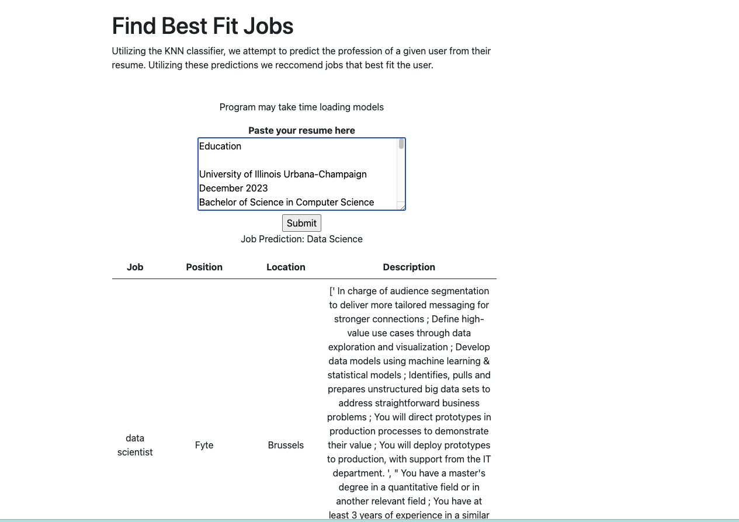
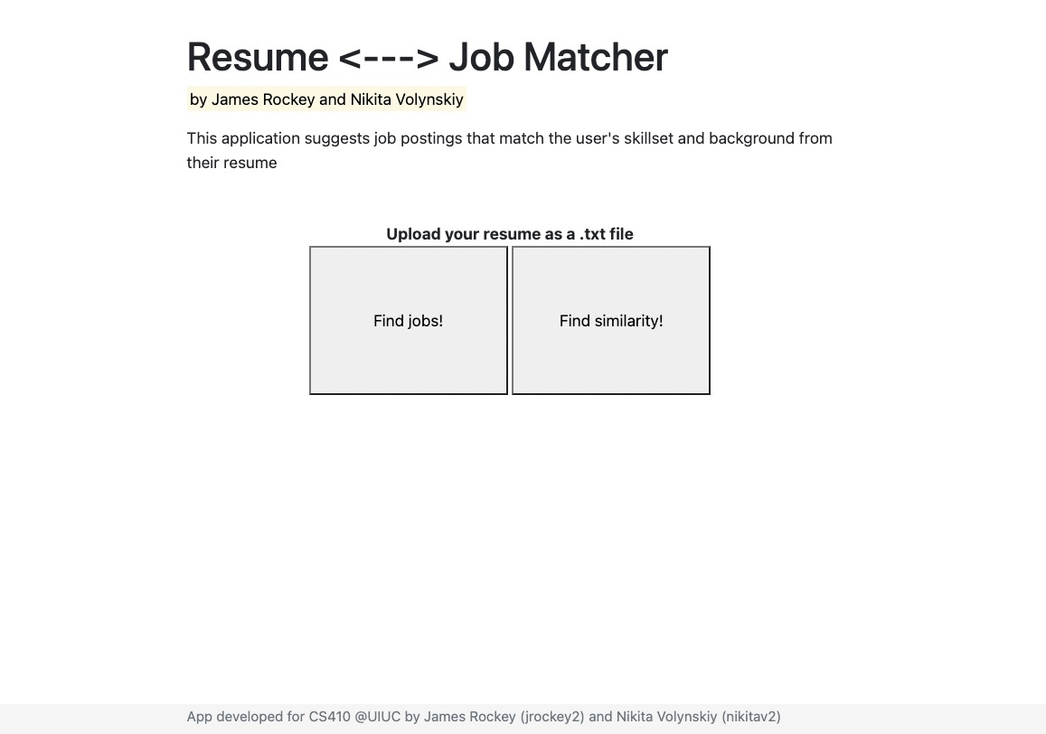
Front-End Design

